Slide 1

Curve Tracking using Pure Pursuit

Slide 2
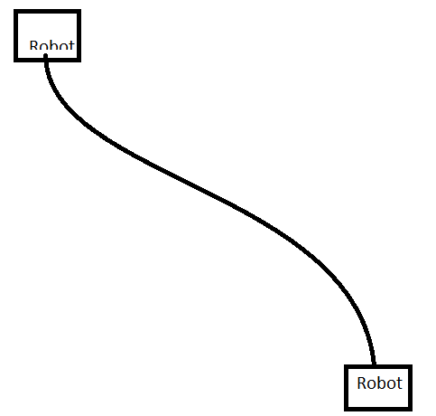
Curve Tracking
A set of coordinates with no time information
Global way points

Slide 3
Pure Pursuit
Determine the current location of the robot
Find the closest way point to the robot
Find the goal
Calculate the curvature and control the robot to set its steering to the curvature
Update the location of the vehicle

Slide 4
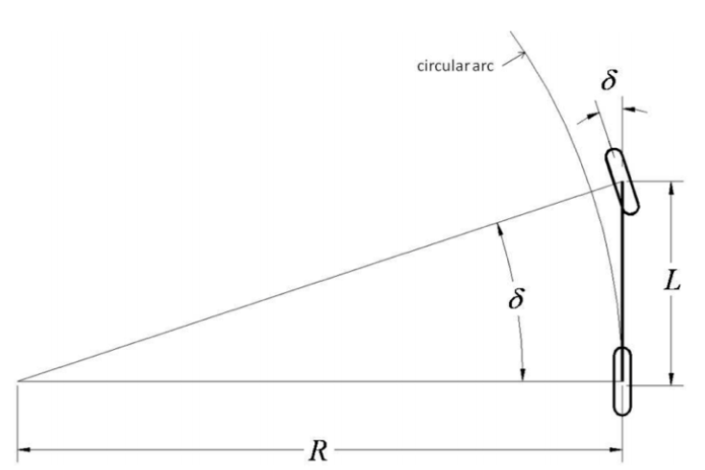
Bicycle model
tan(δ) = L/R

Slide 5
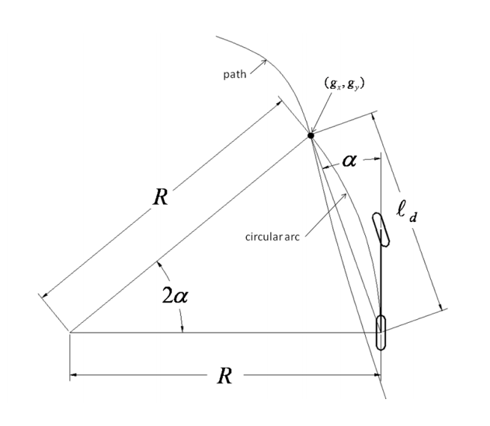
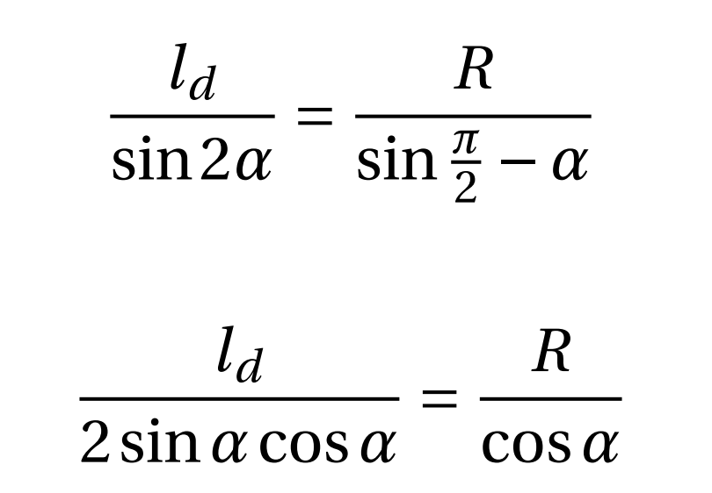
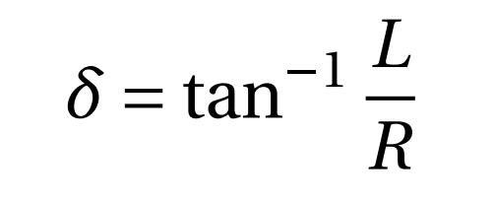
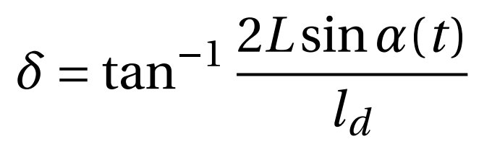
Pure Pursuit

Slide 6
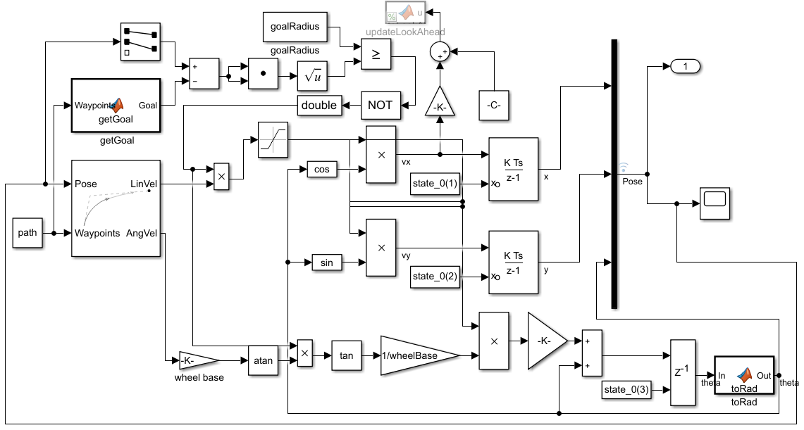
Simulation

Slide 7
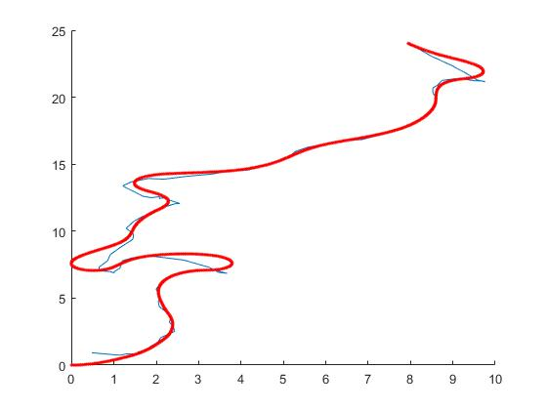
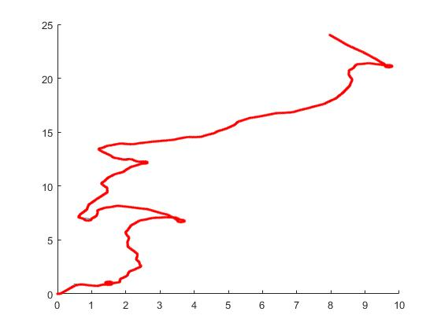
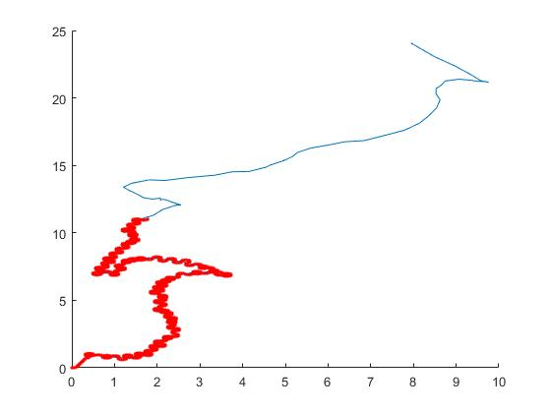
Results
ld = 1
ld = 0.1
ld = 0.001

Slide 8
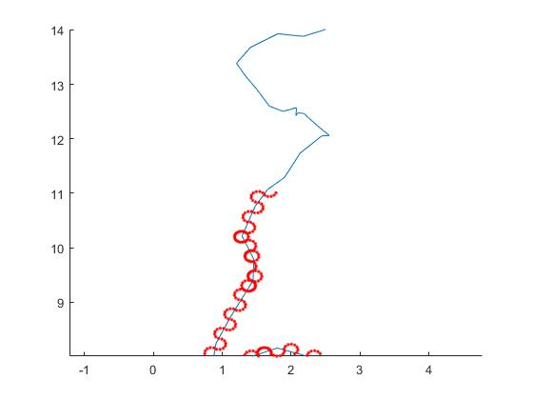
Results
ld = 0.001
Oscillating
Small ld -> accurate
Large ld -> smooth

Slide 9
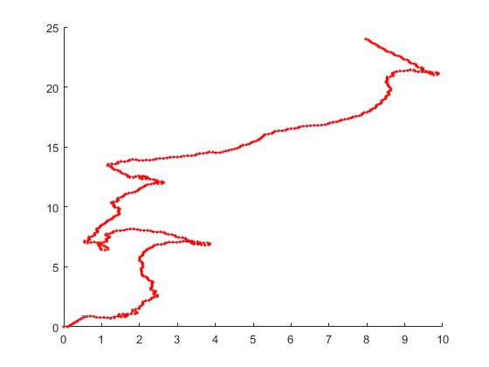
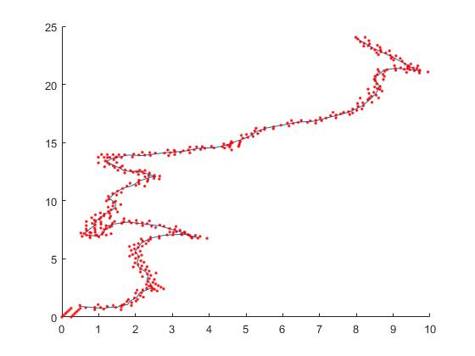
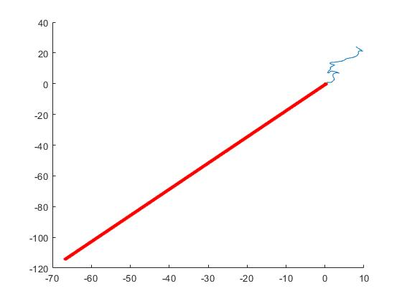
Results
V = 5
V = 10
V = 25
V = 40

Slide 10
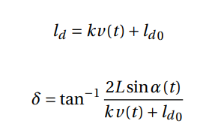
Results
A dynamic assignment of ld
V = 40

